Slide 1
Webinar: OGC API – Maps Sprint|
Gobe Hobona
July, 2020
#OGCAPI

Slide 2
Agenda
Welcome
Motivation for the Sprint
OGC API - Maps draft specification
Description of sprint
Questions & Answers

Slide 5
Welcome
OGC invites you to the OGC API – Maps Sprint being held virtually on:
Day 1: Tuesday 28 July from 09:00am to 05:30pm EDT.
Day 2: Wednesday 29 July from 09:00am to 05:00pm EDT.
What is an OGC Sprint?
A collaborative and inclusive event driven by innovative and rapid programming with minimum process and organization constraints to support the development of new applications and open standards.

Slide 6
Motivation
The increasing need for interoperability between Web APIs
The growing uptake of location within non-traditional geospatial developer communities
Maps continue to be key decision-making support tools

Slide 7
Overview of the draft specification
OGC API - Maps

Slide 8
Sprint Description
The scope of the code sprint is to include:
Specification development
API implementation and testing, using OpenAPI 3.0
Participants are welcome to bring partial or complete implementations of servers or clients to support the sprint.
Participants will have the opportunity to experiment with parts of the specification and develop working services.

Slide 9
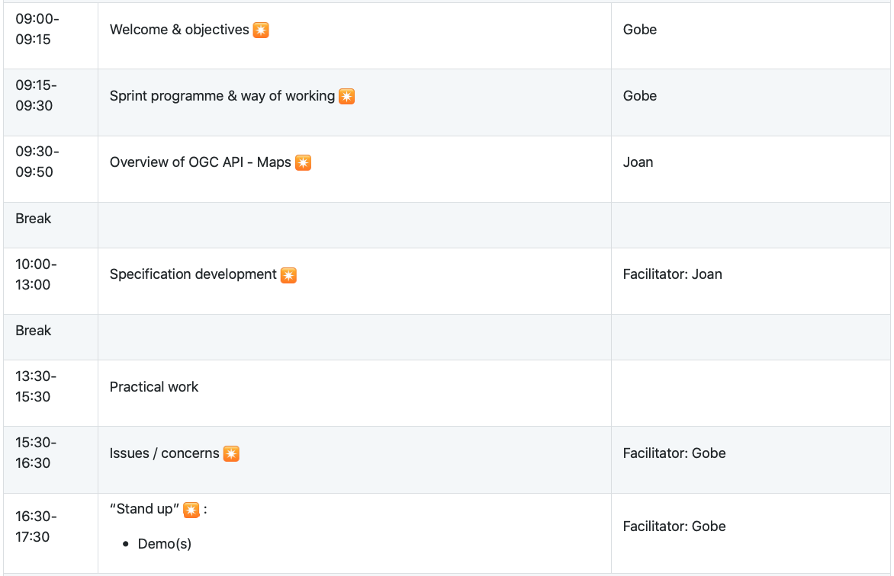
Sprint Schedule: July 28th, 2020

Slide 10
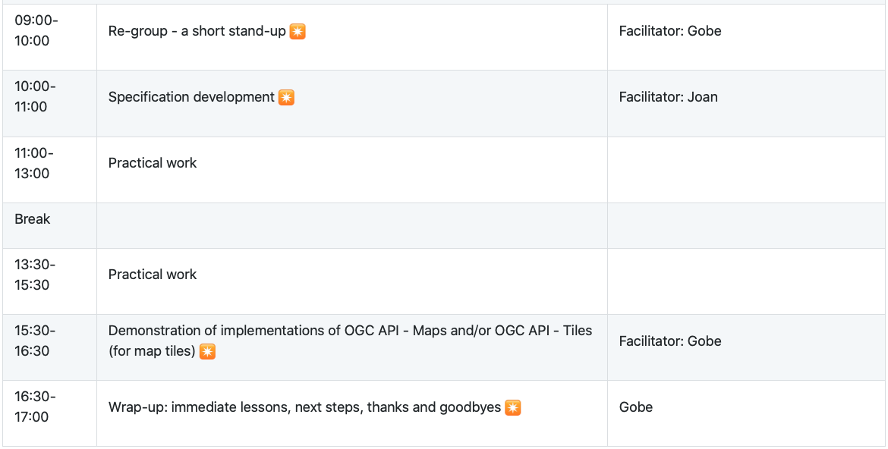
Sprint Schedule: July 29th, 2020

Slide 11
Logistics
Gotomeeting
Link to be provided to registered participants only.
Gitter
https://gitter.im/opengeospatial/OGC-API-Sprint-July-2020
GitHub
Sprint repo https://github.com/opengeospatial/OGC-API-Sprint-July-2020
Specification repo https://github.com/opengeospatial/OGC-API-Maps
Issues
Specification issues https://github.com/opengeospatial/OGC-API-Maps/issues
Sprint issues https://github.com/opengeospatial/OGC-API-Sprint-July-2020/issues

Slide 12
Community
500+ International Members
110+ Member Meetings
60+ Alliance and Liaison partners
50+ Standards Working Groups
45+ Domain Working Groups
25+ Years of Not for Profit Work 10+ Regional and Country Forums
Innovation
120+ Innovation Initiatives
380+ Technical reports
Quarterly Tech Trends monitoring
Standards
65+ Adopted Standards
300+ products with 1000+ certified implementations
1,700,000+ Operational Data Sets Using OGC Standards
Contact info@ogc.org to schedule a meeting for an in-depth discussion with OGC staff and join our community today!
Notes:
If you have any questions, do not hesitate to reach out to OGC or schedule a follow-up. We’re working constantly to change the landscape of location information and want to help your organization get where it needs to go.

